Slide 1
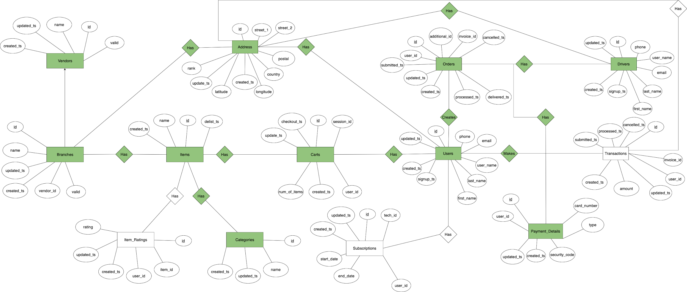
Carriage’s ER Diagram - Conceptual

Slide 2
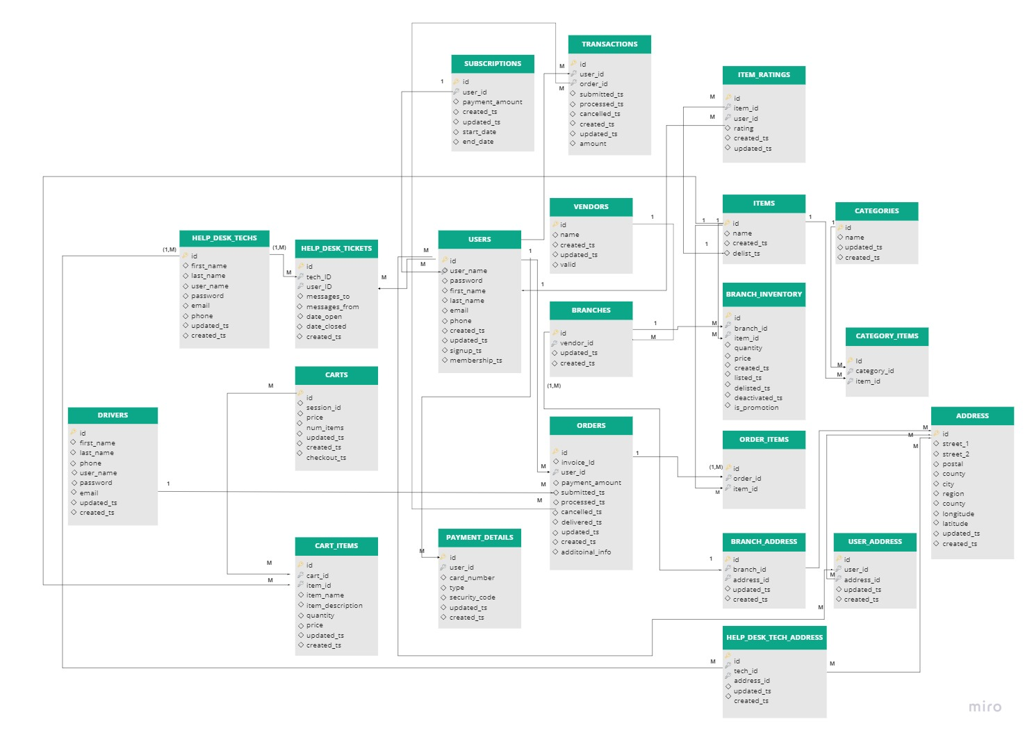
Carriage’s ER Diagram - Logical

